Slide 1
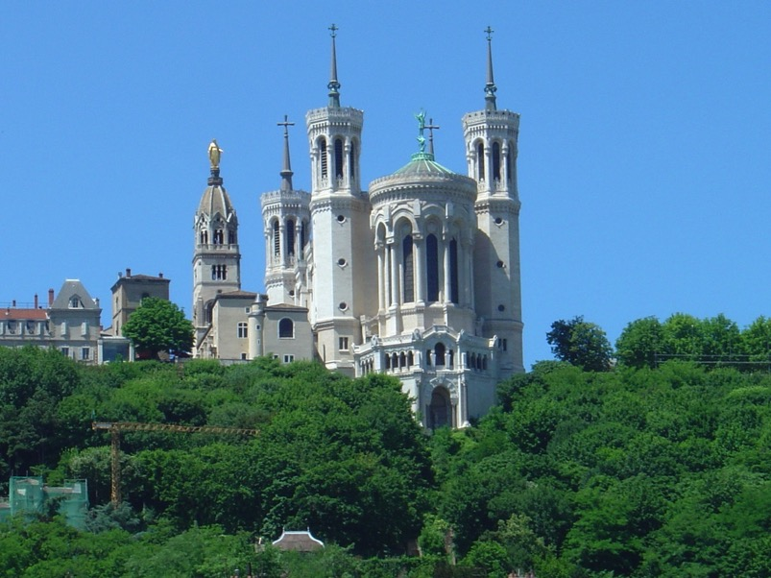
The Basilica Notre-Dame de Fourvière sits high atop the Fourvière Hill in Lyon, France. It was built between 1872 and 1876 in a neo-Byzantine style and was consecrated in 1896. The original chapel is on the left of the basilica.

Slide 2
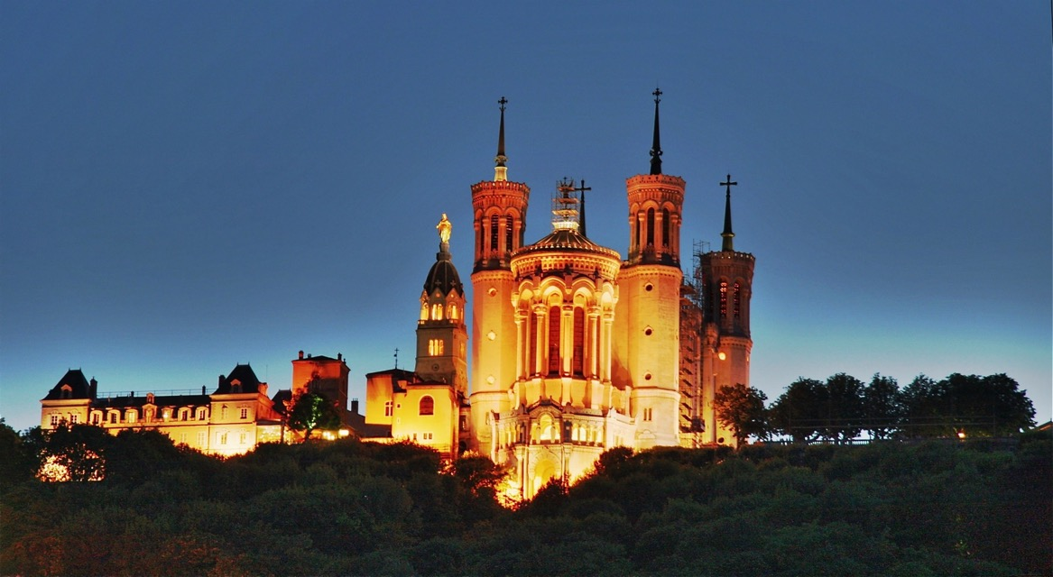
The Basilica at night looking up from the city of Lyon

Slide 3
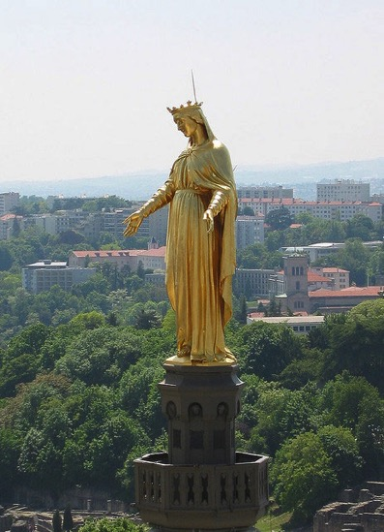
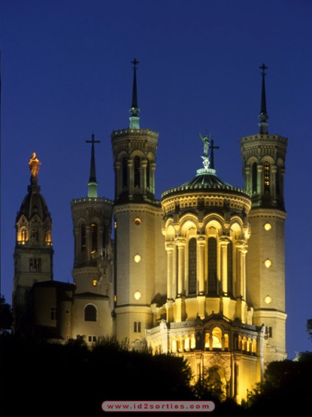
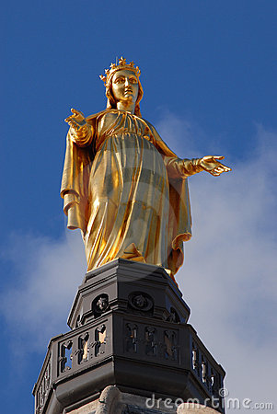
Fourviere has always been a popular place of pilgrimage. The chapel and parts of the building have been rebuilt at different times. When the city of Lyon was spared in the Franco-Prussian War (1870), the community committed to build the present Basilica alongside the ancient chapel.

Slide 4
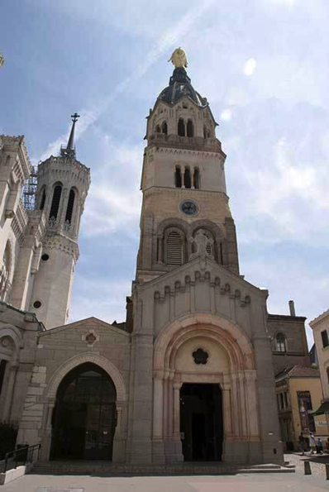
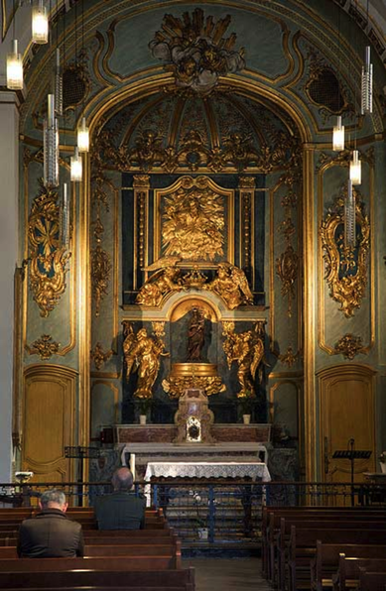
Entrance to the ancient chapel at Fourvière. The altar of the ancient chapel where the first Marists made their pledge in 1816.

Slide 5
The Basilica of Notre-Dame de Fourviere
There has been a shrine at Fourviere dedicated to Mary since 1170 and it has always been a popular place of pilgrimage.
The interior of the chapel was restored in 1751, and the tower surmounted by the golden statue of Mary was added in 1856.
The new Basilica was consecrated in 1896.
On 23rd July 1816 the twelve Marist aspirants, priests and seminarians, including Marcellin Champagnat, climbed the hill to the shrine of Our Lady of Fourviere. They placed their promise to found the Society of Mary under the white cloth on the altar while Fr Jean-Claude Courveille celebrated Mass.
After communion they read out their declaration promising to devote themselves and all that they had to the foundation of the Society of Mary.
In October 1836 before the departure of the first missionaries for Oceania, Bishop Pompallier celebrated a novena of Masses there, and on the final day Fr Peter Chanel SM, hung a heart containing the names of the missionaries around the neck of the Infant Jesus, giving birth to the legend that Mary had given her mantle to the future martyr.
In the years which followed, many Marists came on pilgrimage to the shrine.

Slide 6
Fourviere Pledge, 23 July 1816 - All for the greater glory of God and the greater honour of Mary, Mother of the Lord Jesus.
We the undersigned, striving to work together for the greater glory of God and the honour of Mary, Mother of the Lord Jesus, assert and declare our sincere intention and firm will of consecrating ourselves at the first opportunity to founding the pious congregation of Mary-ists. That is why by the present act and our signatures, in so far as we can, we irrevocably dedicate ourselves and all our goods to the Society of the blessed Virgin.
We do this not childishly or lightly or for some human motive or the hope of material benefit, but seriously, maturely, having taken advice, having weighed everything before God, solely for the greater Glory of God and the honour of Mary, Mother of the Lord Jesus.

Slide 7
Fourviere Pledge continued
We pledge ourselves to accept all sufferings, trials, inconveniences, and if needs be, torture, because we can do all things in Christ Jesus who strengthens us and to whom we hereby promise fidelity in the bosom of our holy mother the Roman Catholic Church, cleaving with all our strength to its supreme head the Roman Pontiff and to our most reverend bishop, the ordinary, that we may be good ministers of Jesus Christ, nourished by the words of faith and by the wholesome teaching which by his grace we have received.
We trust that under the reign of our most Christian King*, the friend of peace and religion, this institute will shortly come to light and we solemnly promise that we shall spend ourselves and all we have in saving souls in every way under the very august name of the Virgin Mary and with her help. And may the holy and immaculate conception of the Blessed Virgin Mary be praised. Amen.
*The Monarchy was restored in 1814, after Napoleon’s reign. Louis XVIII was King until 1824.

Slide 8
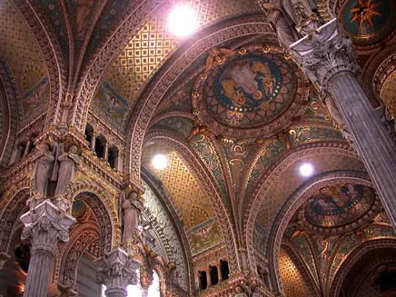
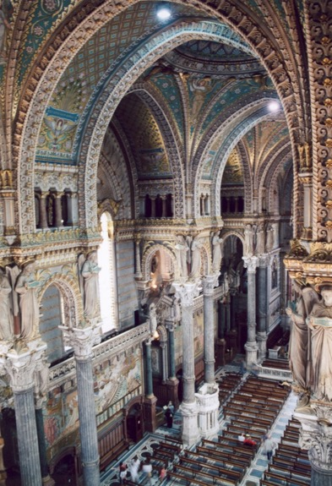
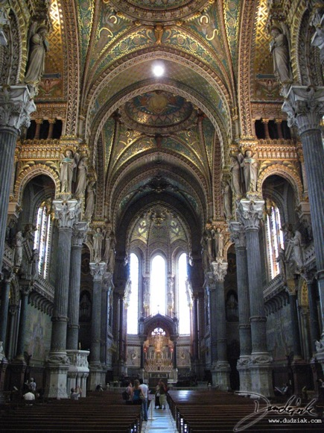
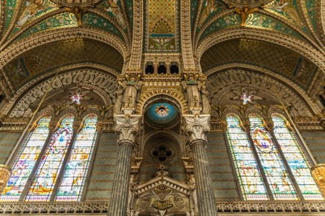
Some interior views of the new Basilica

Slide 9
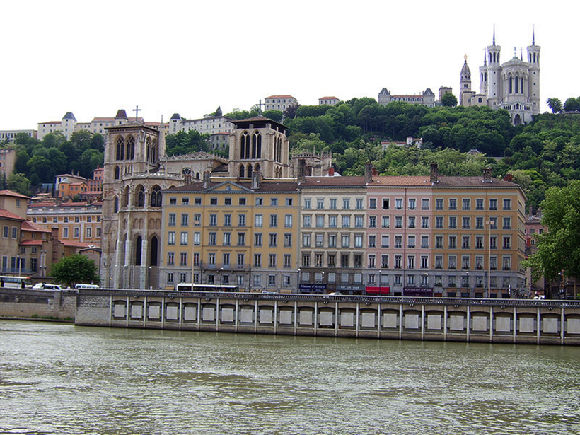
The Basilica: the view from the River Saone. The Cathedral of Saint-Jean-Baptiste de Lyon is in the left foreground. It was begun in the 12th century and completed in 1476

Slide 10
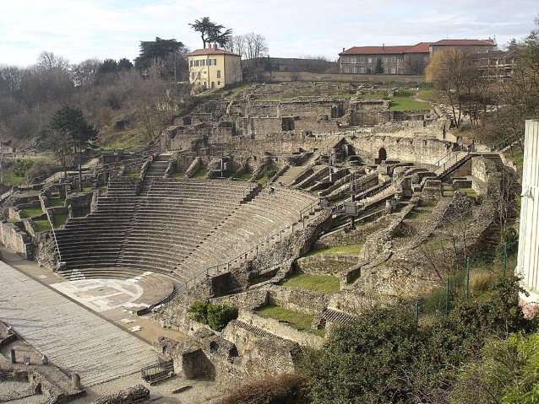
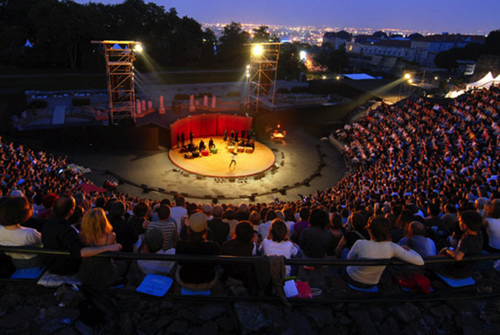
Roman Theatre on Fourvière hill very close to the basilica
The theatre was built in two stages: around 15 BC, a theatre with a 90 m diameter was built. At the beginning of the 2nd century, the final part was added. The diameter is 108 m, and there were seats for 10,000 people.
The theatre is now primarily a tourist site but it is still used as a cultural venue.

